Slide 1
The Lord, the Bible, the Holy Spirit, Christians
Darkness- the world, the flesh, and the Devil
The Renewing of the Mind- part 5
(Apprehending the blessings of our salvation in Christ)
Understanding
Believing
Appropriating
Acknowledging
Receiving
Accepting

Slide 2
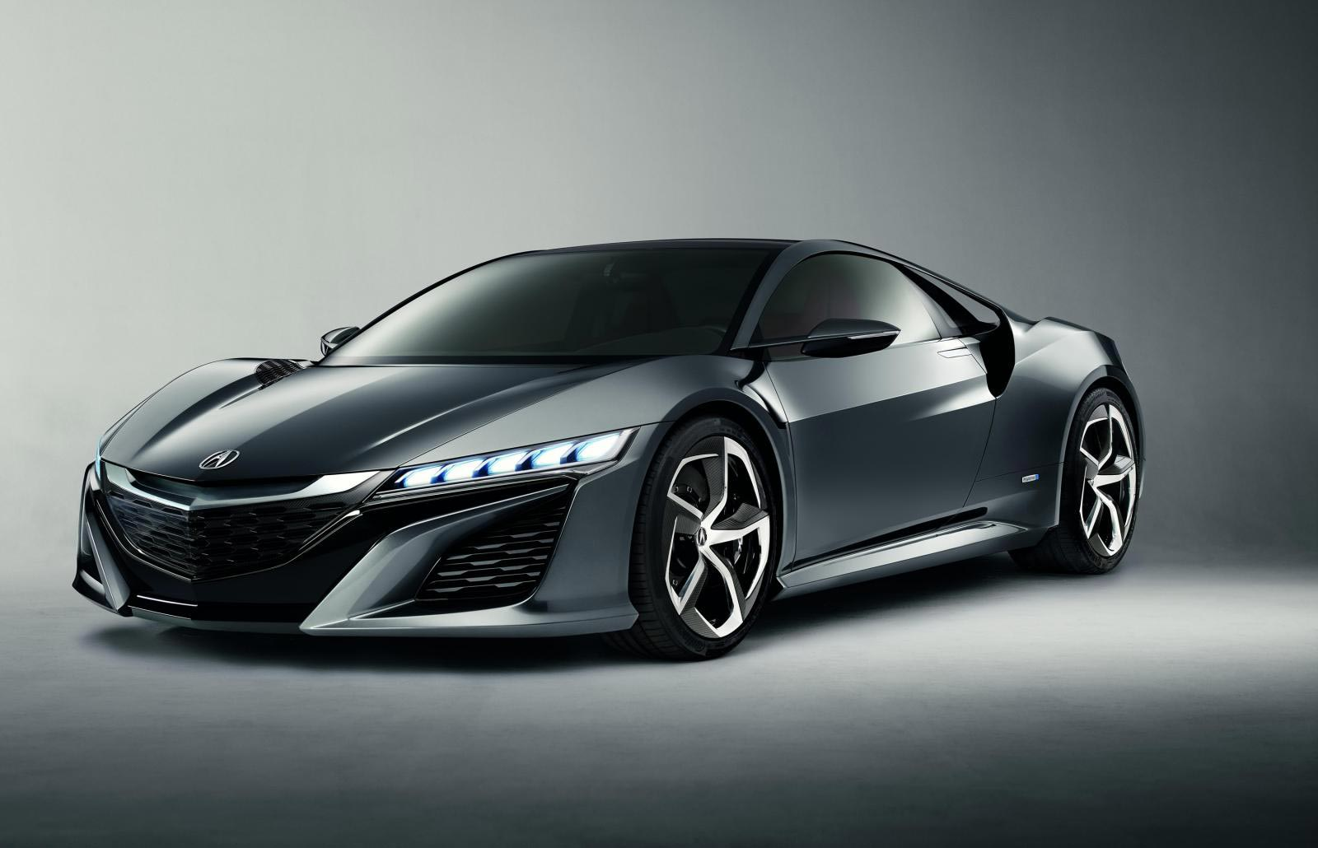
Where and when does the renewing of the mind begin?

Slide 3
John 3:3
Jesus answered and said to him, “Most assuredly, I say to you, unless one is born again, he cannot see the kingdom of God.”

Slide 4
John 1: 11 and 12
11 He came to His own, and His own did not receive Him.
12 But as many as received Him, to them He gave the right to become children of God, to those who believe in His name.

Slide 5
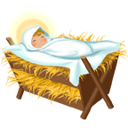
Please notice how many times the words gave and gift are used in the verses we will look at. Think about, at this Christmas Season, what God has given to us.

Slide 6
Romans 12: 1 and 2
1 I beseech you therefore, brethren, by the mercies of God, that you present your bodies a living sacrifice, holy, acceptable to God, which is your reasonable service.
2 And do not be conformed to this world, but be transformed by the renewing of your mind, that you may prove what is that good and acceptable and perfect will of God.
Do not let the world squeeze you into its mold

Slide 7
Ephesians 2:1-3
1 And you He made alive, who were dead in trespasses and sins,
2 in which you once walked according to the course of this world, according to the prince of the power of the air, the spirit who now works in the sons of disobedience,
3 among whom also we all once conducted ourselves in the lusts of our flesh, fulfilling the desires of the flesh and of the mind, and were by nature children of wrath, just as the others.

Slide 8
Ephesians 2:4-7
4 But God, who is rich in mercy, because of His great love with which He loved us,
5 even when we were dead in trespasses, made us alive together with Christ (by grace you have been saved),
6 and raised us up together, and made us sit together in the heavenly places in Christ Jesus,
7 that in the ages to come He might show the exceeding riches of His grace in His kindness toward us in Christ Jesus.

Slide 9
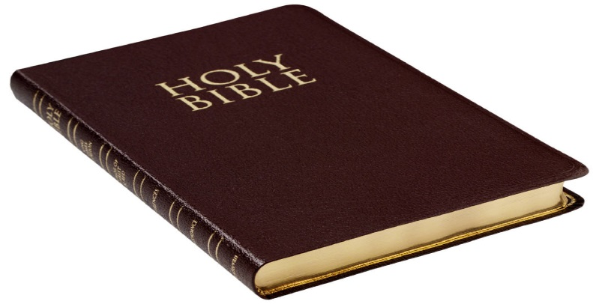
2 Peter 1:2-4
2 Grace and peace be multiplied to you in the knowledge of God and of Jesus our Lord,
3 as His divine power has given to us all things that pertain to life and godliness, through the knowledge of Him who called us by glory and virtue,
4 by which have been given to us exceedingly great and precious promises, that through these you may be partakers of the divine nature, having escaped the corruption that is in the world through lust.

Slide 10
We have the peace of God and peace with God.

Slide 11
Luke 2:13 and 14
13 And suddenly there was with the angel a multitude of the heavenly host praising God, and saying,
14 Glory to God in the highest, and on earth peace, good will toward men.

Slide 12
John 16:33
33 "These things I have spoken to you, that in Me you may have peace. In the world you will have tribulation; but be of good cheer, I have overcome the world."

Slide 13
Romans 1:7
7 To all who are in Rome, beloved of God, called to be saints: Grace to you and peace from God our Father and the Lord Jesus Christ.

Slide 14
Philippians 4:6 and 7
6 Be anxious for nothing, but in everything by prayer and supplication, with thanksgiving, let your requests be made known to God;
7 and the peace of God, which surpasses all understanding, will guard your hearts and minds through Christ Jesus.

Slide 15
declared righteous
Romans 5:1 and 2
1 Therefore, having been justified by faith, we have peace with God through our Lord Jesus Christ,
2 through whom also we have access by faith into this grace in which we stand, and rejoice in hope of the glory of God.

Slide 16
John 14:27
27 "Peace I leave with you, My peace I give to you; not as the world gives do I give to you. Let not your heart be troubled, neither let it be afraid.

Slide 17
2Peter 1:2
2 Grace and peace be multiplied to you in the knowledge of God and of Jesus our Lord,

Slide 18
Colossians 3:15
15 And let the peace of God rule in your hearts, to which also you were called in one body; and be thankful.

Slide 19
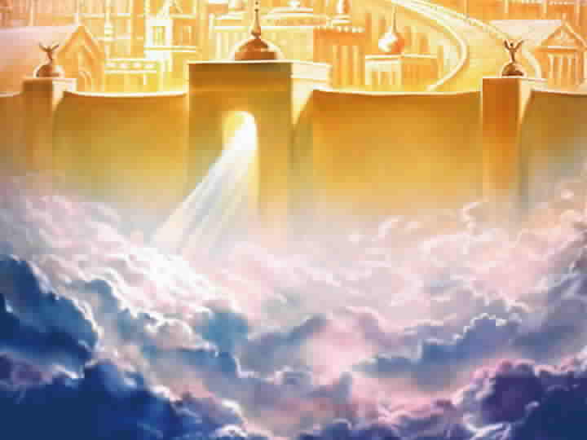
We are given and assured of eternal life

Slide 20
John 3:14-17
14 "And as Moses lifted up the serpent in the wilderness, even so must the Son of Man be lifted up,
15 "that whoever believes in Him should not perish but have eternal life.
16 "For God so loved the world that He gave His only begotten Son, that whoever believes in Him should not perish but have everlasting life.
17 "For God did not send His Son into the world to condemn the world, but that the world through Him might be saved.

Slide 21
John 10:27-30
27 "My sheep hear My voice, and I know them, and they follow Me.
28 "And I give them eternal life, and they shall never perish; neither shall anyone snatch them out of My hand.
29 "My Father, who has given them to Me, is greater than all; and no one is able to snatch them out of My Father's hand.
30 "I and My Father are one."

Slide 22
Romans 6:23
23 For the wages of sin is death, but the gift of God is eternal life in Christ Jesus our Lord.

Slide 23
1Timothy 6:12
12 Fight the good fight of faith, lay hold on eternal life, to which you were also called and have confessed the good confession in the presence of many witnesses.

Slide 24
1John 2:25
25 And this is the promise that He has promised us--eternal life.

Slide 25
1John 5:11-13
11 And this is the testimony: that God has given us eternal life, and this life is in His Son.
12 He who has the Son has life; he who does not have the Son of God does not have life.
13 These things I have written to you who believe in the name of the Son of God, that you may know that you have eternal life, and that you may continue to believe in the name of the Son of God.

Slide 26
Renewing of our minds:
1.Our minds can be renewed-we have been born again
2.We have God’s promises in His Word
3.God is our Father- we are His children
4.We are loved by the Father and by Christ
    5.Our relationship with God is eternally secure
    6.We have the indwelling Holy Spirit
7. Jesus Christ is our great High Priest
8.We have forgiveness of sins
9.We have been made righteous in Christ
10.We have been delivered from Satan’s power
11.We have been delivered to God’s power
12. We have the peace of God and peace with God 13. We are assured of eternal life

Slide 27
